Slide 1




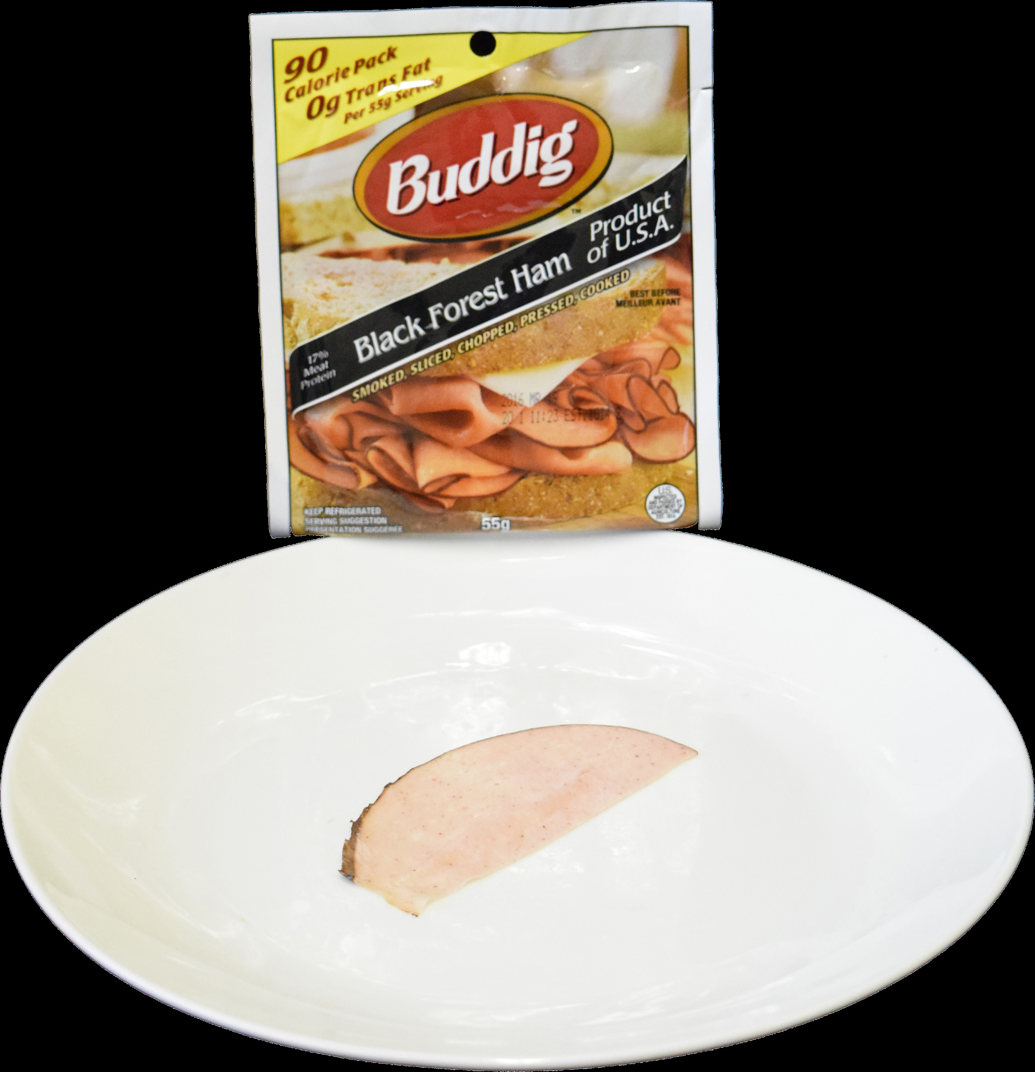



Taboo for you?: Computational insights into sacred values
and cost-benefit tradeoffs
Cendri A. Hutcherson¹ & Yoel Inbar¹
¹ Department of Psychology, University of Toronto
BACKGROUND
METHODS
People often act as if certain moral values are so important that they cannot be traded off against secular benefits (e.g., “you can’t put a price on human life”).
Sacred values are thus characterized by outcome insensitivity and quantity insensitivity (rejection of tradeoffs no matter how large the offsetting benefit or how small the violation: Baron & Spranca, 1997)
How people construct value for “taboo tradeoffs” is poorly understood (c.f. Berns et al., 2012)
Use computational insights from drift diffusion models (DDMs) to study sacred values in real, incentive compatible context
Explore how uncompromising rejection of tradeoffs arises: is consideration of benefits inhibited or are benefits considered but too small to offset moral cost? DDM suggests that rejection should become increasingly difficult (i.e., longer RTs) if benefits are valued.
Explore the computational dynamics of sacred values: are they rapid and automatic or supported by slower, more deliberative mechanisms?
Participants: 91 volunteers (22 expressing moral or religious food restrictions, 63 with no restrictions).
Food choice task: Computer mouse movements tracked as Pps chose whether to eat a particular food for a particular monetary amount, ranging from $0 up to $26.
3 Food Types, 4 quantities: 5 $ Offers
$0-1
Taboo (e.g. ham) $4-$6
Unappealing (e.g. baby food) $9-$11
Appealing (e.g. candy) $14-$16
$24-$26
Post-choice rating task: Foods rated for moral uncleanness, liking, and disgust.
Analyses:
Final choice - H1: 100% rejection for sacred values
Final RTs - H2: influence by $
Mouse-tracking: regression predicting heading at each
timept t to estimate when variables influence decision value
H(t) = w₁*Moral + w₂*Money + w₃*Liking + w₄*Quantity
Permutation correction used to determine significant time periods
H3a: Early influence of $ = gradual inhibition of temptation
H3b: Late influence of $ = automatic rejection followed by temptation
$25
GOALS
Heading at time t = 60
Heading at time t = 30
Initial Choice
(1st deviation from initial heading)
Heading at time t = 1
RESULTS
SUBJECTIVE RATINGS DISTINGUISH TABOO FOODS
TABOO FOODS ARE UNCONDITIONALLY REJECTED
**
Pps w/ no taboo
Pps w/ religious taboo
**
Appealing Foods
Unappealing Foods
Taboo Foods
ns
*
**
+
% Acceptance
% Acceptance
% Acceptance
$1
$5
$10
$15
$25
$1
$5
$10
$15
$25
$1
$5
$10
$15
$25
Taboo
Unappealing
Appealing
Taboo
Unappealing
Appealing
% Acceptance
% Acceptance
% Acceptance
As expected, Pps w/ religious taboo rate taboo foods more morally unclean, less liked. Smaller differences in ratings of other foods.
RTS FOR NON-TABOO FOODS CORRELATE W/ ACCEPTANCE
$1
$5
$10
$15
$25
$1
$5
$10
$15
$25
RTS FOR TABOO FOOD SUGGEST BENEFITS ARE CONSIDERED
Appealing Foods
(All Pps)
22 Pps rejected 100% of unappealing (but non-taboo) foods for offers < $16. We hypothesized that RTs in this range predict likelihood of acceptance for offers > $16.
1. Calculate individual Pp’s sensitivity to $ for trials < $16
RT = β_{Money}*Offer + β₀ + ε
2. Correlate β_{Money} with % acceptance for offers > $16
In non-taboo context, RTs reveal sensitive to money, even in subset of trials where choices do not vary
Taboo Foods
(100% rejection)
Response Time
*
$1
$5
$10
$15
$25
r = .48
P = .01
Response Time
Unappealing Foods
(All Pps)
% Acceptance
Response Time
* P < .05
$1
$5
$10
$15
$25
$1
$5
$10
$15
$25
Individual β_{Money}
Analysis of RTs indicates subtle but significant sensitivity to monetary offer, suggesting that religious Pps may be considering benefits even while consistently rejecting them.
DYNAMICS SUGGEST LATE VALUATION OF BENEFITS
CONCLUSIONS
Mouse movements reveal that non-taboo decision values were shaped by several factors from early on. For taboo foods, only moral cleanness and money shaped movements, comparatively late in the trial.
Food decisions are an incentive compatible, potent context for investigating moral and religious taboos
Analyses in non-religious Pps confirm that RTs from trials involving 100% rejection can be used to predict if more money will lead to acceptance
Despite ultimate disavowal, RTs and dynamic mouse movements suggest that benefits of taboo tradeoffs are considered, after rapid initial rejection.
Future work using neuroimaging and individual analysis may reveal mechanisms of both rigidity and compromise for sacred values
Non-taboo Foods (All Pps)
Taboo Foods (Religious Pps)
Init. RT
Final RT
Init. RT
Final RT
**
Liking
*
Moment-by-moment
Effect on Heading
**
Money
Moment-by-moment
Effect on Heading
**
Quantity
**
**
Moral disgust
Corresponding author: Cendri Hutcherson (c.hutcherson@utoronto.ca)
Time (ms)
* P < .05 ** P < .001 (permutation corrected)
Time (ms)

